Slide 1


Slide 2




Slide 3
Priče sa klijentske strane
Visual Studio 2015 / ASP.NET 5
Miroslav Popović
Abacus Solutions and Consulting

Slide 4



Slide 5
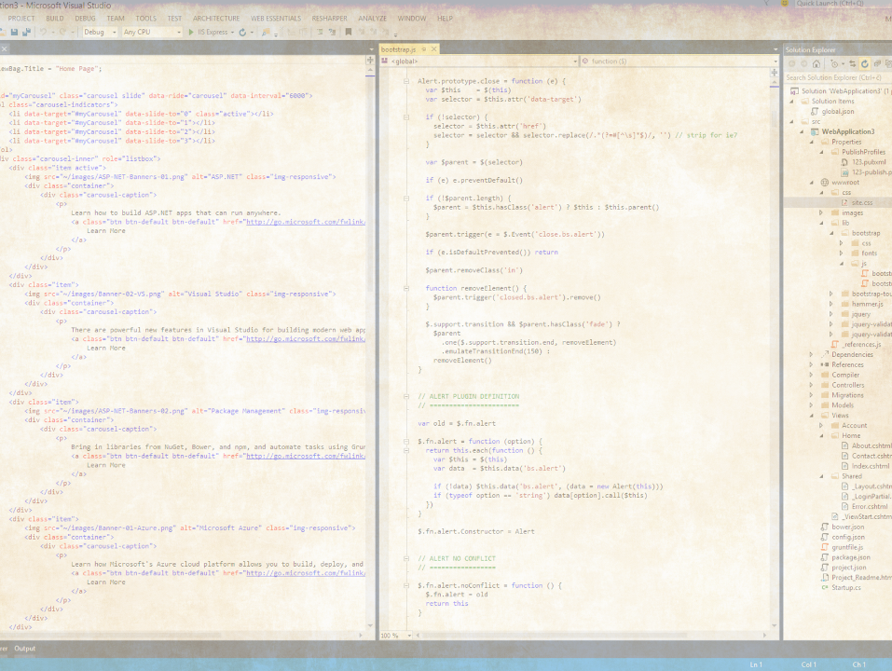
Malo istorije

Slide 6
Visual Studio <= 2010
Web razvoj tijesno vezan uz ASP.NET
Nepraktičan za jednostavne statičke sajtove
Kaskanje za web standardima
ASP.NET MVC
HTML5 sveprisutnost
Client-side / mobile web aplikacije
Windows Store apps

Slide 7
Visual Studio 2012/2013
Potpuno novi editori za HTML, JavaScript i CSS
HTML5
ECMAScript 5
CSS3
LESS, SASS, JSON,
TypeScript, CoffeScript
Mustache, Handlebars…
Bootstrap, Knockout, Angular…

Slide 8

Nova struktura web projekta
http://www.bustler.net/index.php/article/3xn_to_design_landmark_structure_in_stockholm/
Notes:
Image source: http://www.bustler.net/index.php/article/3xn_to_design_landmark_structure_in_stockholm/

Slide 9
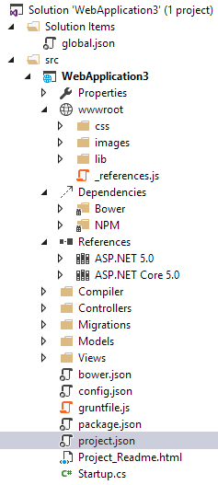
Demo

Slide 10
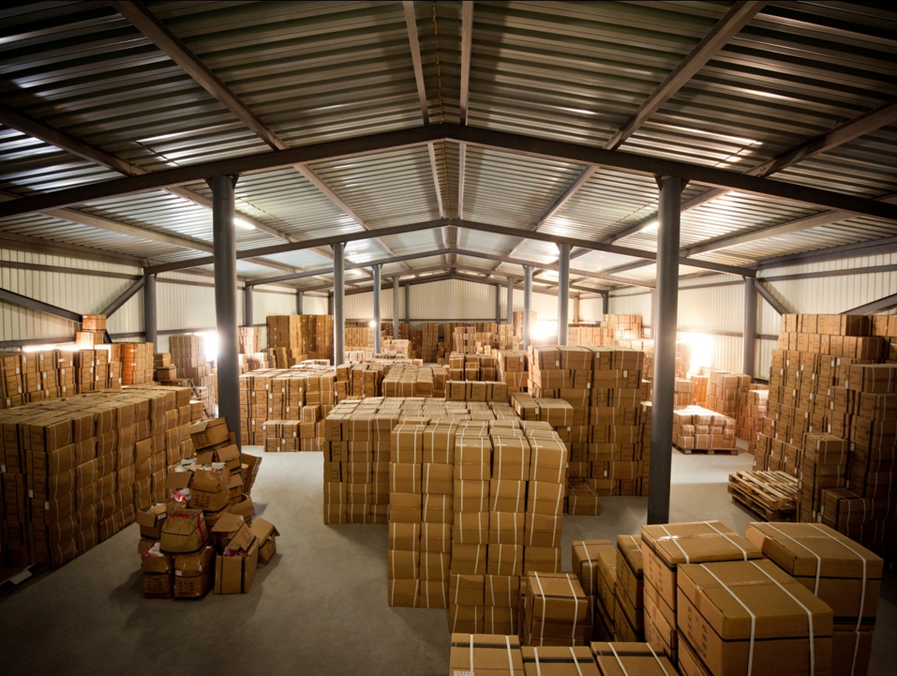
Package management

Slide 11
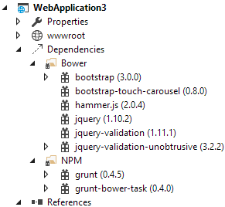
Package management
NuGet nije dovoljan?
Npm i Bower
Jspm…?
Notes:
Npm i Bower:
Dependencies tree,
Restore packages
package.json IntelliSense
bower.json IntelliSense

Slide 12
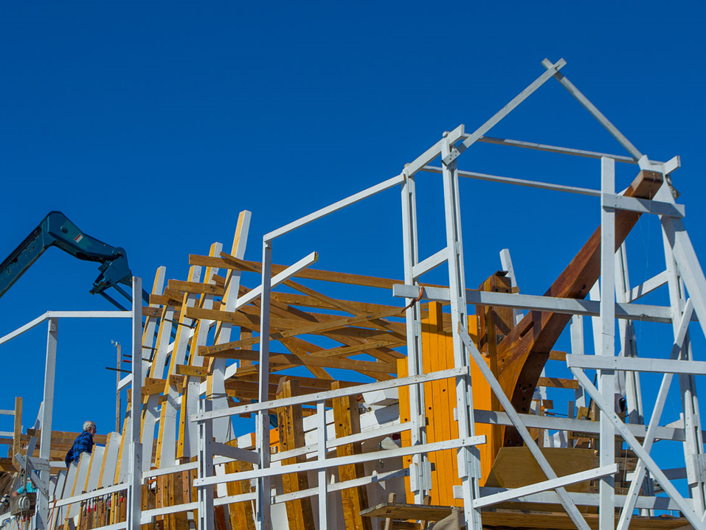
Build alati
http://commons.wikimedia.org/wiki/File:San_Salvador_Build_Site-11.jpg

Slide 13
Build alati
MSBuild
Grunt
Gulp
Task Runner Explorer
Notes:
Gruntfile.js, gulpfile.js...
Uglify, watch…

Slide 14

Jezici
Source: Shutterstock

Slide 15
Jezici
Visual Studio 2015 podržava
TypeScript
CoffeScript
Less
Sass
Ne podržava
ES6 ☹
Dart
Stylus

Slide 16

Testiranje

Slide 17
Testiranje
Jasmine, QUnit, Mocha
http://mmanela.github.io/chutzpah/
Karma (Testacular)
http://mortenhoustonludvigsen.github.io/KarmaTestAdapter/
Protractor
End-to-end testiranje

Slide 18
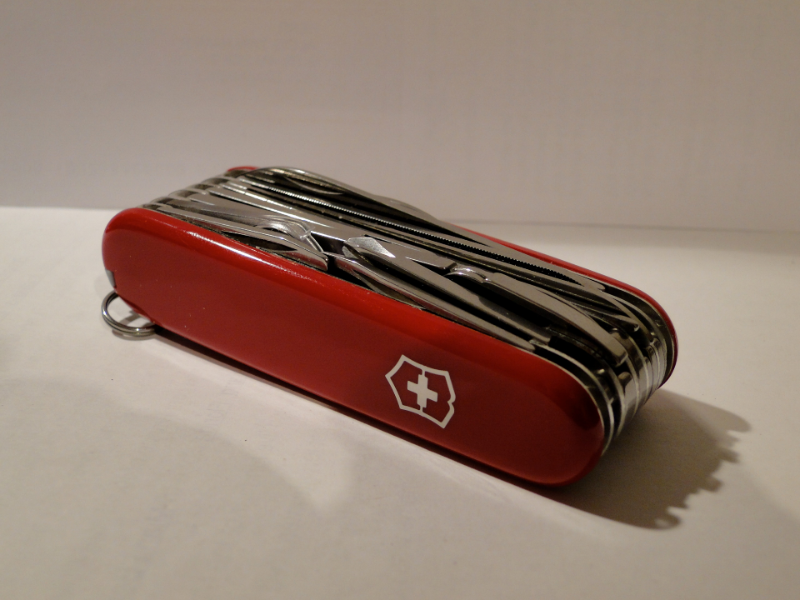
Ostalo
http://en.wikipedia.org/wiki/Victorinox

Slide 19
BrowserLink
Povezuje Visual Studio i browsere
Radi refresh svih povezanih browsera
Posjeduje API za proširenja
Browser Link Dashboard

Slide 20
Ostali alati
JSHint, JSLint, bundling, minification, … – izbačeno iz Web Essentials 2015
JDoc
Web Essentials
SideWaffle

Slide 21
Ostalo
Node.js tools
Angular
Markdown

Slide 22

Budućnost
https://www.flickr.com/photos/stuckincustoms/6341844005

Slide 23
Budućnost
ES6/7 + moduli
CSS4
Web Components
Angular
React – JSX
Jspm
Aurelia

Slide 24
Hvala! Pitanja?
Primjeri: https://github.com/miroslavpopovic/msnetwork5-sample

Slide 25


Slide 26



Ne zaboravite ispuniti upitnike.
Čekaju vas vrijedne nagrade!

